Slide 1
Finding Presence of a Handle on Social Media Platform
Teammates
Ashok Bhobhiya(181IT154)
Channamallikarjuna(181IT212)
Shivprasad Nayak(181IT149)

Slide 2
Abstract
Today, more and more people have their virtual identities on the web. It is common that people are users of more than one social network and also their friends may be registered on multiple websites. A facility to aggregate our online friends into a single integrated environment would enable the user to keep up-to-date with their virtual contacts more easily, as well as to provide improved facility to search for people across different websites. In social media networks, profile details of one user can be used by others to create an account with original user identity or the original user may have multiple accounts in multiple social media sites. Discovery of multiple accounts that belong to the same person is an interesting and challenging work in social media analysis. Profiles, contents and network structures can be used for user identification in social media sites. We are conducting a survey in this paper to identify the identical users among multiple social media sites based on the profile details of the users.

Slide 3
Introduction
After the search engine, social network is another hot Web application which involves the user as an active element in the transactions.The success of social networking websites, such as Facebook, MSN Spaces, and others, shows the revolution of Web 2.0.
Users have their “second life” on the web, a virtual environment to meet friends, discuss opinions, play online games and share information.
Currently, different social networking websites use different ways to store and display information about a user user's Web profile.Also, due to business and privacy concerns, services from different providers communicate less and only provide basic important functions which should be manually driven by the users.
As a result, the users’ preferences for different social networking websites make the exchange of friends’ information problematic.
The method presented in this project may be applied, for example, in creating a Web-based people search facility. This facility could be used to search for individuals in a number of social networks and produce a consolidated result with duplicated user profiles identified and their profiles “summarized”.

Slide 4
.
This would be a step forward compared to current people Search engines, which produce separate search results for each social network.
Another application might include a super social network website to provide a single environment for users to access their virtual life. Users could link their accounts from different social networks and the super networking website would consolidate all their details and friends’ profiles.
In this way, the user would have a simple and effective way of keeping up-to-date with their friends’ activities and communicating with them across all social networks from a single environment. For a user of multiple social networks, there is increased overhead in keeping up-to-date with friends’ activities.
There is also increased complexity in choosing the “right” communication platform; that being simply the one used by a particular friend of the user at a particular time. Taken from a different perspective, people searching becomes another challenge. As people are registered on one or more websites, performing a simple search across a number of social networking websites only produces separate (but possibly overlapping) results for each social network domain.

Slide 5
Objectives
There are many types of social networking sites which immensely contributed large number of real world data on social behaviors. People tend to use multiple social media sites for different purposes and all the existent social media sites will satisfy some user needs. Before using any social network, the user has to be registered to
the network by submitting their profile information. It is possible to gather the user’s information from different social networks. For instance, Facebook offers a view to
the profiles of the users’, LinkedIn reveals professional profiles and Twitter broadcasts interests. This knowledge can be exploited and it is a serious threat to the user’s privacy.
This system will be useful for those people who are fond of social networking sites and like to use different web applications.
This system brings people to come together from different corners of the world.
This system will help people to find their old friends.
This system helps to find out duplicate users on different social networking sites.
This system will allow user to view his friends who are online on other social networking sites into a single integrated environment

Slide 6
Requirements:
Software Requirements:
Ubuntu 16.04 or Higher
Python 3+ version
Visual Studio 2010
Hardware Components:
Processor – Core i3
Hard Disk – 160 GB
Memory – 1GB RAM
Monitor

Slide 7
Methodology
Modules:
Forming the URLs
Http GET request
Analysing the Response
Libraries Used:
Urllib
Requests
ThreadPool
Beautiful Soup

Slide 8
Forming the URLs
Forming the URLs
URLs will be formed by making a string that has a website module and the username .
For example: 'https://'+uname+url where ,
url is like www.facebook.com

Slide 9
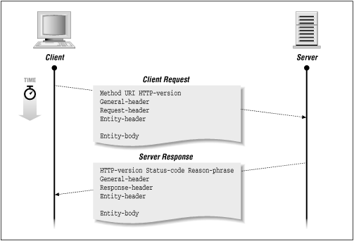
Http GET request

Slide 10
Analyse the response
After sending a GET request we will get back the http node that has information about the success of the GET request.
We have to read the HTTP header to get to know about the http code. ex. 200 , 404 etc.
In the final step will get to know about the status of the username on the particular platform.

Slide 11
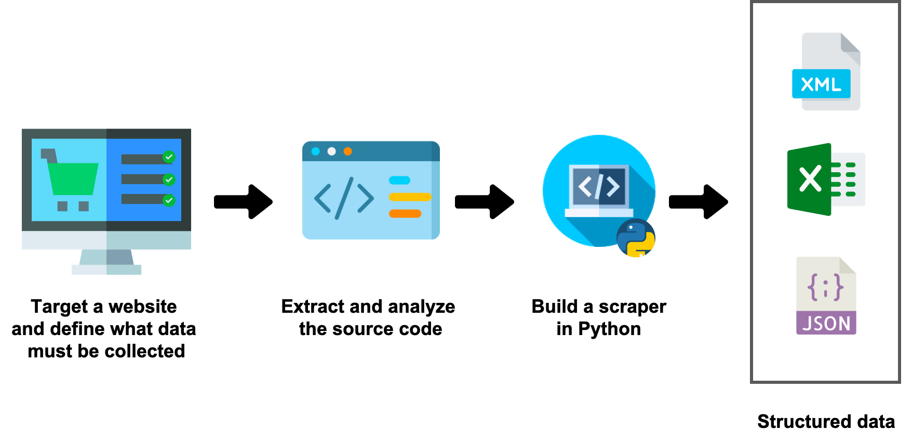
Contd...
Extracting data from HTML

Slide 12
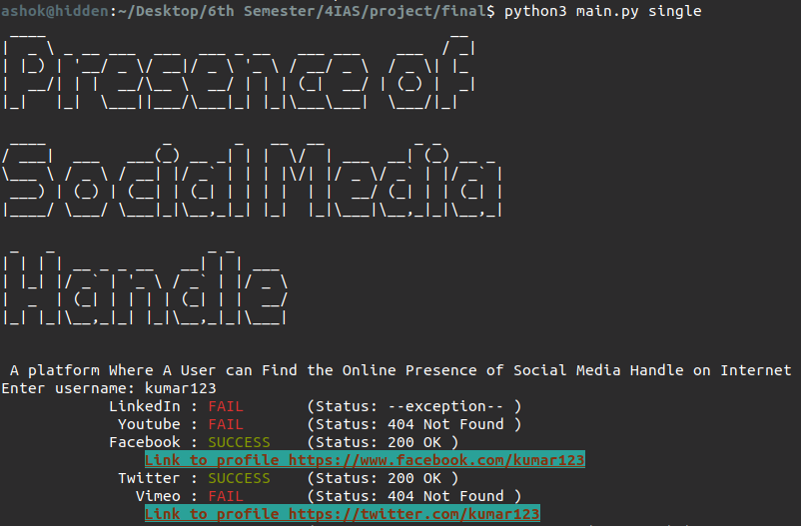
Results

Slide 13
contd...
In this image the summary of the single user search is shown

Slide 14

contd...
In this image the summary of the dataset search is shown.

Slide 15
Conclusion
It is like OSINT (open source intelligence) when we will take information from open source websites.
This system will be useful for those people who are fond of social networking sites and likes to use different web application.
This system helps to find out duplicate users on different social networking sites.
It also helps to find the most common username in the given datasets of users.

Slide 16
Thank You

